Slide 1
Measurement: Scaling, Reliability, Validity

Slide 2
Concept
In our daily life we are said to measure when we use some yardstick to determine weight, height, or some other feature of a physical object.
We also measure when we judge how well we like a song, a painting or the personalities of our friends. We, thus, measure physical objects as well as abstract concepts.
Measurement is a relatively complex and demanding task, specially so when it concerns qualitative or abstract phenomena.
By measurement we mean the process of assigning numbers to objects or observations, the level of measurement being a function of the rules under which the numbers are assigned.

Slide 3
Measurement and Scaling
It is easy to assign numbers in respect of properties of some objects, but it is relatively difficult in respect of others. For instance, measuring such things as social conformity, intelligence, or marital adjustment is much less obvious and requires much closer attention than measuring physical weight, biological age or a person’s financial assets.
In other words, properties like weight, height, etc., can be measured directly with some standard unit of measurement, but it is not that easy to measure properties like motivation to succeed, ability to stand stress and the like.
We can expect high accuracy in measuring the length of pipe with a yard stick, but if the concept is abstract and the measurement tools are not standardized, we are less confident about the accuracy of the results of measurement.

Slide 4
Measurement Scale
Technically speaking, measurement is a process of mapping aspects of a domain onto other aspects of a range according to some rule of correspondence. In measuring, we devise some form of scale in the range (in terms of set theory, range may refer to some set) and then transform or map the properties of objects from the domain (in terms of set theory, domain may refer to some other set) onto this scale. For example, in case we are to find the male to female attendance ratio while conducting a study of persons who attend some show, then we may tabulate those who come to the show according to sex. In terms of set theory, this process is one of mapping the observed physical properties of those coming to the show (the domain) on to a sex classification (the range). The rule of correspondence is: If the object in the domain appears to be male, assign to “0” and if female assign to “1”. Similarly, we can record a person’s marital status as 1, 2, 3 or 4, depending on whether the person is single, married, widowed or divorced. We can as well record “Yes or No” answers to a question as “0” and “1” (or as 1 and 2 or perhaps as 59 and 60). In this artificial or nominal way, categorical data (qualitative or descriptive) can be made into numerical data and if we thus code the various categories, we refer to the numbers we record as nominal data. Nominal data are numerical in name only, because they do not share any of the properties of the numbers we deal in ordinary arithmetic. For instance if we record marital status as 1, 2, 3, or 4 as stated above,= we cannot write 4 > 2 or 3 < 4 and we cannot write 3 – 1 = 4 – 2, 1 + 3 = 4 or 4 ¸ 2 = 2.
3

Slide 5
Measurement scale
In those situations when we cannot do anything except set up inequalities, we refer to the data as ordinal data. For instance, if one mineral can scratch another, it receives a higher hardness number and on Mohs’ scale the numbers from 1 to 10 are assigned respectively to talc, gypsum, calcite, fluorite, apatite, feldspar, quartz, topaz, sapphire and diamond. With these numbers we can write 5 > 2 or 6 < 9 as apatite is harder than gypsum and feldspar is softer than sapphire, but we cannot write for example 10 – 9 = 5 – 4, because the difference in hardness between diamond and sapphire is actually much greater than that between apatite and fluorite. It would also be meaningless to say that topaz is twice as hard as fluorite simply because their respective hardness numbers on Mohs’ scale are 8 and 4. The greater than symbol (i.e., >) in connection with ordinal data may be used to designate “happier than” “preferred to” and so on.

Slide 6
Measurement and Scaling
When in addition to setting up inequalities we can also form differences, we refer to the data as interval data. Suppose we are given the following temperature readings (in degrees Fahrenheit): 58°, 63°, 70°, 95°, 110°, 126° and 135°. In this case, we can write 100° > 70° or 95° < 135° which simply means that 110° is warmer than 70° and that 95° is cooler than 135°. We can also write for example 95° – 70° = 135° – 110°, since equal temperature differences are equal in the sense that the same amount of heat is required to raise the temperature of an object from 70° to 95° or from 110° to 135°. On the other hand, it would not mean much if we said that 126° is twice as hot as 63°, even though 126° ¸ 63° = 2. To show the reason, we have only to change to the centigrade scale, where the first temperature becomes 5/9 (126 – 32) = 52°, the second temperature becomes 5/9 (63 – 32) = 17° and the first figure is now more than three times the second. This difficulty arises from the fact that Fahrenheit and Centigrade scales both have artificial origins (zeros) i.e., the number 0 of neither scale is indicative of the absence of whatever quantity we are trying to measure.
When in addition to setting up inequalities and forming differences we can also form quotients (i.e., when we can perform all the customary operations of mathematics), we refer to such data as ratio data. In this sense, ratio data includes all the usual measurement (or determinations) of length, height, money amounts, weight, volume, area, pressures etc.
The above stated distinction between nominal, ordinal, interval and ratio data is important for the nature of a set of data may suggest the use of particular statistical techniques*. A researcher has to be quite alert about this aspect while measuring properties of objects or of abstract concepts.

Slide 7
Scales
There are four basic types of scales:
Nominal Scale
Ordinal Scale
Interval Scale
Ratio Scale

Slide 8
Types of scales
Nominal scale: Nominal scale is simply a system of assigning number/ symbols to events in order to label them. The usual example of this is the assignment of numbers of basketball players in order to identify them.
Such numbers cannot be considered to be associated with an ordered scale because their order is of no consequence; the numbers are just convenient labels for the particular class of events and as such have no quantitative value. Nominal scales provide convenient ways of keeping track of people, objects and events. One cannot do much with the numbers involved.
For example, one cannot usefully average the numbers on the back of a group of football players and come up with a meaningful value. Neither can one usefully compare the numbers assigned to one group with the numbers assigned to another. The counting of members in each group is the only possible arithmetic operation when a nominal scale is employed.
Accordingly, we are restricted to use mode as the measure of central tendency. There is no generally used measure of dispersion for nominal scales. Chi-square test is the most common test of statistical significance that can be utilized, and for the measures of correlation, the contingency coefficient can be worked out.

Slide 9
Nominal scales
Nominal scale is the least powerful level of measurement. It indicates no order or distance relationship and has no arithmetic origin. A nominal scale simply describes differences between things by assigning them to categories. Nominal data are, thus, counted data.
The scale wastes any information that we may have about varying degrees of attitude, skills, understandings, etc. In spite of all this, nominal scales are still very useful and are widely used in surveys and other ex-post-facto research when data are being classified by major sub-groups of the population.

Slide 10
Types of Scale
Ordinal scale: The lowest level of the ordered scale that is commonly used is the ordinal scale. The ordinal scale places events in order, but there is no attempt to make the intervals of the scale equal in terms of some rule. Rank orders represent ordinal scales and are frequently used in research relating to qualitative phenomena. A student’s rank in his graduation class involves the use of an ordinal scale.
One has to be very careful in making statement about scores based on ordinal scales. For instance, if Ram’s position in his class is 10 and Mohan’s position is 40, it cannot be said that Ram’s position is four times as good as that of Mohan. The statement would make no sense at all. Ordinal scales only permit the ranking of items from highest to lowest. Ordinal measures have no absolute values, and the real differences between adjacent ranks may not be equal. All that can be said is that one person is higher or lower on the scale than another, but more precise comparisons cannot be made.
7

Slide 11
Ordinal Scale
Ordinal scale: such scale not only categorizes variables to denote differences among various categories, it also rank-orders categories in some meaningful way.
Rank the following profession by their social status?
O Professor
O Doctor
O lawyer
O Engineer
O CA

Slide 12
Ordinal Scale
The customer preference would be ranked ( from best to worse; or from first to last) and numbered as 1, 2, 3, and so on.

Slide 13
Example 2
Rank the following five characteristics in a job in terms of how important they are for you. (You should rank the most important item as 1, the next 2, and so on, until you have ranked each of them 1, 2, 3, 4, or 5).
  Job Characteristic Ranking
The opportunity provided by the job to:
1. Interacts with others _____
2. Use different skills _____
3. Autonomy in decision-making _____
4. Serve others _____
5. Work independently _____

Slide 14
Ordinal scale
Thus, the use of an ordinal scale implies a statement of ‘greater than’ or ‘less than’ (an equality statement is also acceptable) without our being able to state how much greater or less. The real difference between ranks 1 and 2 may be more or less than the difference between ranks 5 and 6. Since the numbers of this scale have only a rank meaning, the appropriate measure of central tendency is the median. A percentile or quartile measure is used for measuring dispersion. Correlations are restricted to various rank order methods. Measures of statistical significance are restricted to the non-parametric methods

Slide 15
Interval Scale
Interval scale: whereas the nominal scale allows us only to qualitatively distinguish groups by categorizing them into mutually exclusive and collectively exhaustive sets, and the ordinal scale to rank-order the preferences, the interval scale lets us measure the distance between any two points on the scale.

Slide 17
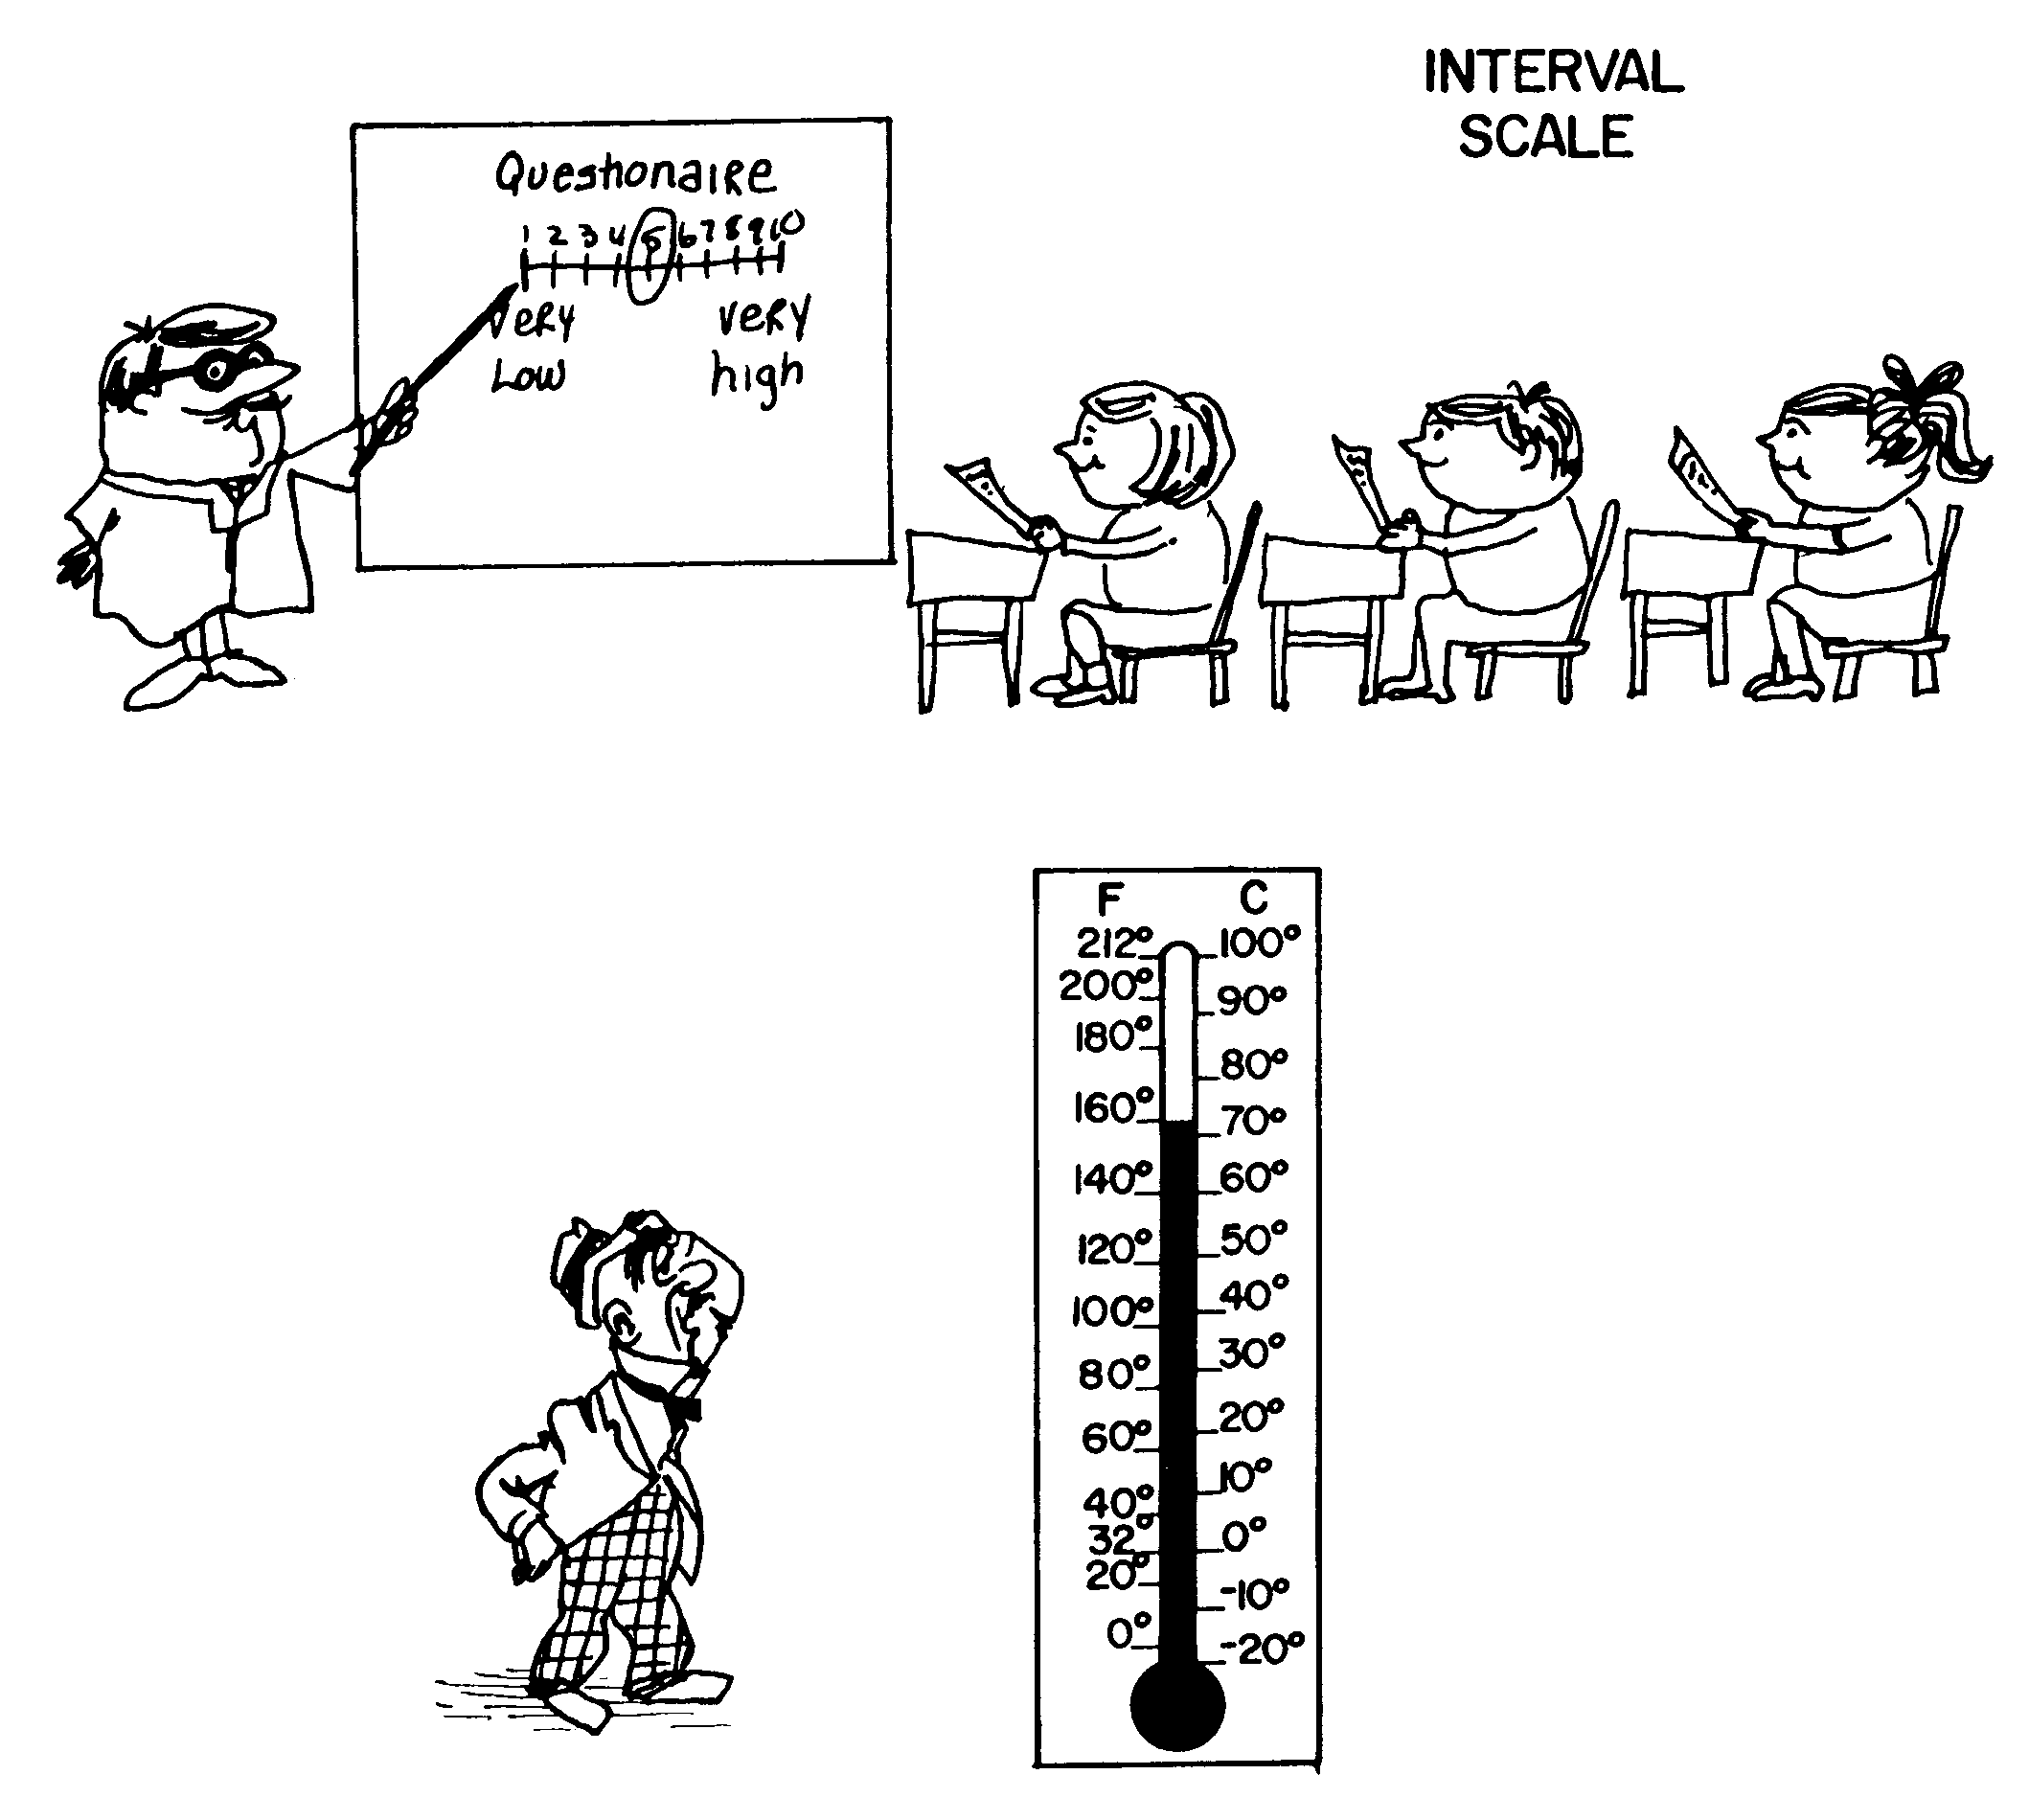
Interval scale
© 2009 John Wiley & Sons Ltd.
www.wileyeurope.com/college/sekaran

Slide 18
Example 3a
Indicate the extent to which you agree with the following statements as they relate to your job, by circling the appropriate number against each, using the scale given below.
strongly disagree 1, Disagree 2
Neither Agree Nor Disagree 3
Agree 4, Strongly Agree 5.

Slide 19
Example 3a (Cont.)
The following opportunities offered by the job are very important to me:
Interacting with others | 1 | 2 | 3 | 4 | 5
Using a number of different skills | 1 | 2 | 3 | 4 | 5
Completing a task from beginning to end | 1 | 2 | 3 | 4 | 5
Serving others | 1 | 2 | 3 | 4 | 5
Working independently | 1 | 2 | 3 | 4 | 5

Slide 20
Example 3a (Cont.)
Suppose that the employees circle the numbers 3, 1, 2, 4, and 5 for the five items.
The magnitude of difference represented by the space between points 1 and 2 on the scale is the same as the magnitude of difference represented by the space between points 4 and 5, or between any other two points. Any number can be added to or subtracted from the numbers on the scale, still retaining the magnitude of the difference.

Slide 21
Example 3a (Cont.)
If we add 6 to the five points on the scale, the interval scale will have the numbers 7, 8,….., 11 ( instead of 1 to 5).
The magnitude of the difference between 7 and 8 is still the same as the magnitude of the difference between 9 and 10. It has an arbitrary origin.

Slide 22
Example 3b
Circle the number that represents your feelings at this particular moment best. There are no right or wrong answers. Please answer every question.
1. I invest more in my work than I get out of it
I disagree completely 1 2 3 4 5 I agree completely
2. I exert myself too much considering what I get back in return
I disagree completely 1 2 3 4 5 I agree completely
3. For the efforts I put into the organization, I get much in return
I disagree completely 1 2 3 4 5 I agree completely

Slide 23
Ratio Scale
Ratio scale: overcomes the disadvantage of the arbitrary origin point of the interval scale, in that it has an absolute (in contrast to an arbitrary) zero point, which is a meaningful measurement point.
What is your age?
26

Slide 24
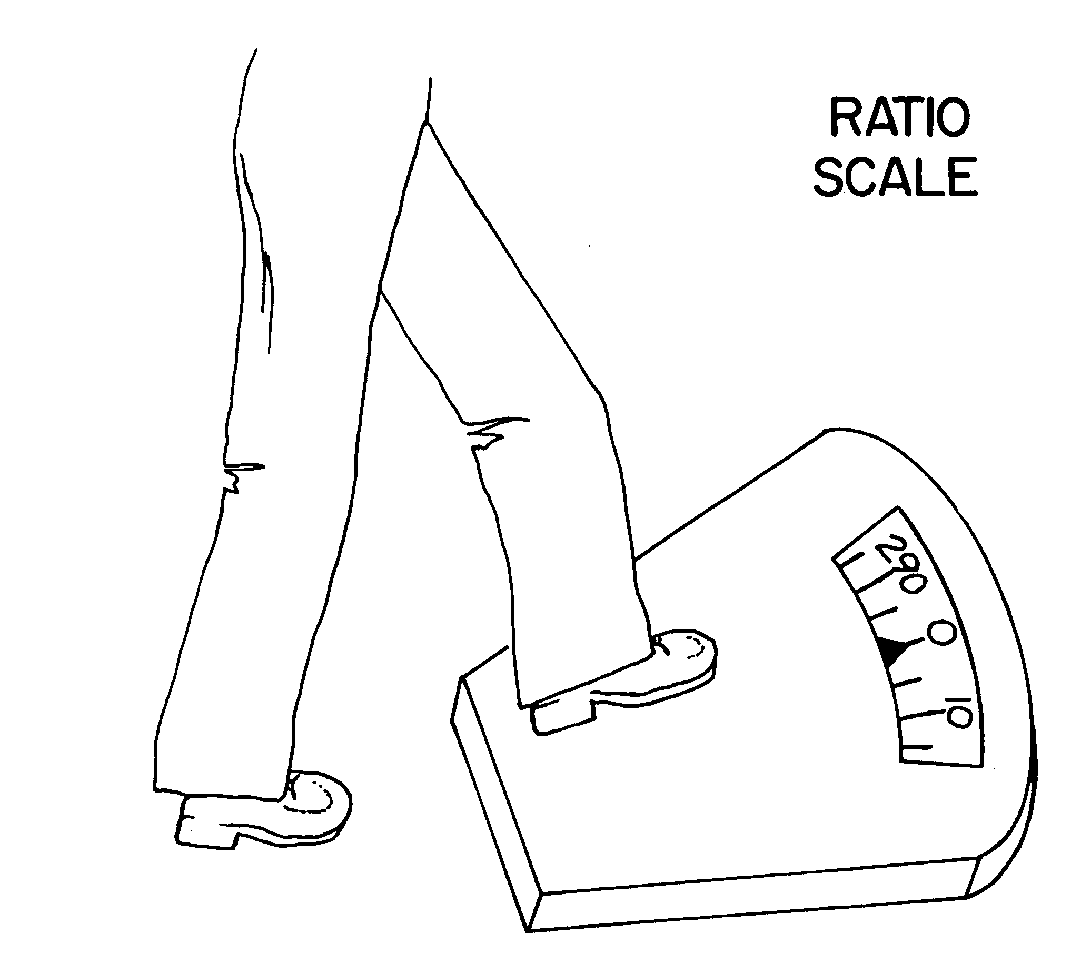
Ratio Scale

Slide 25
Ratio Scale
The ratio scale is the most powerful of the four scales because it has a unique zero origin ( not an arbitrary origin).
The differences between scales are summarized in the next Figure.

Slide 26
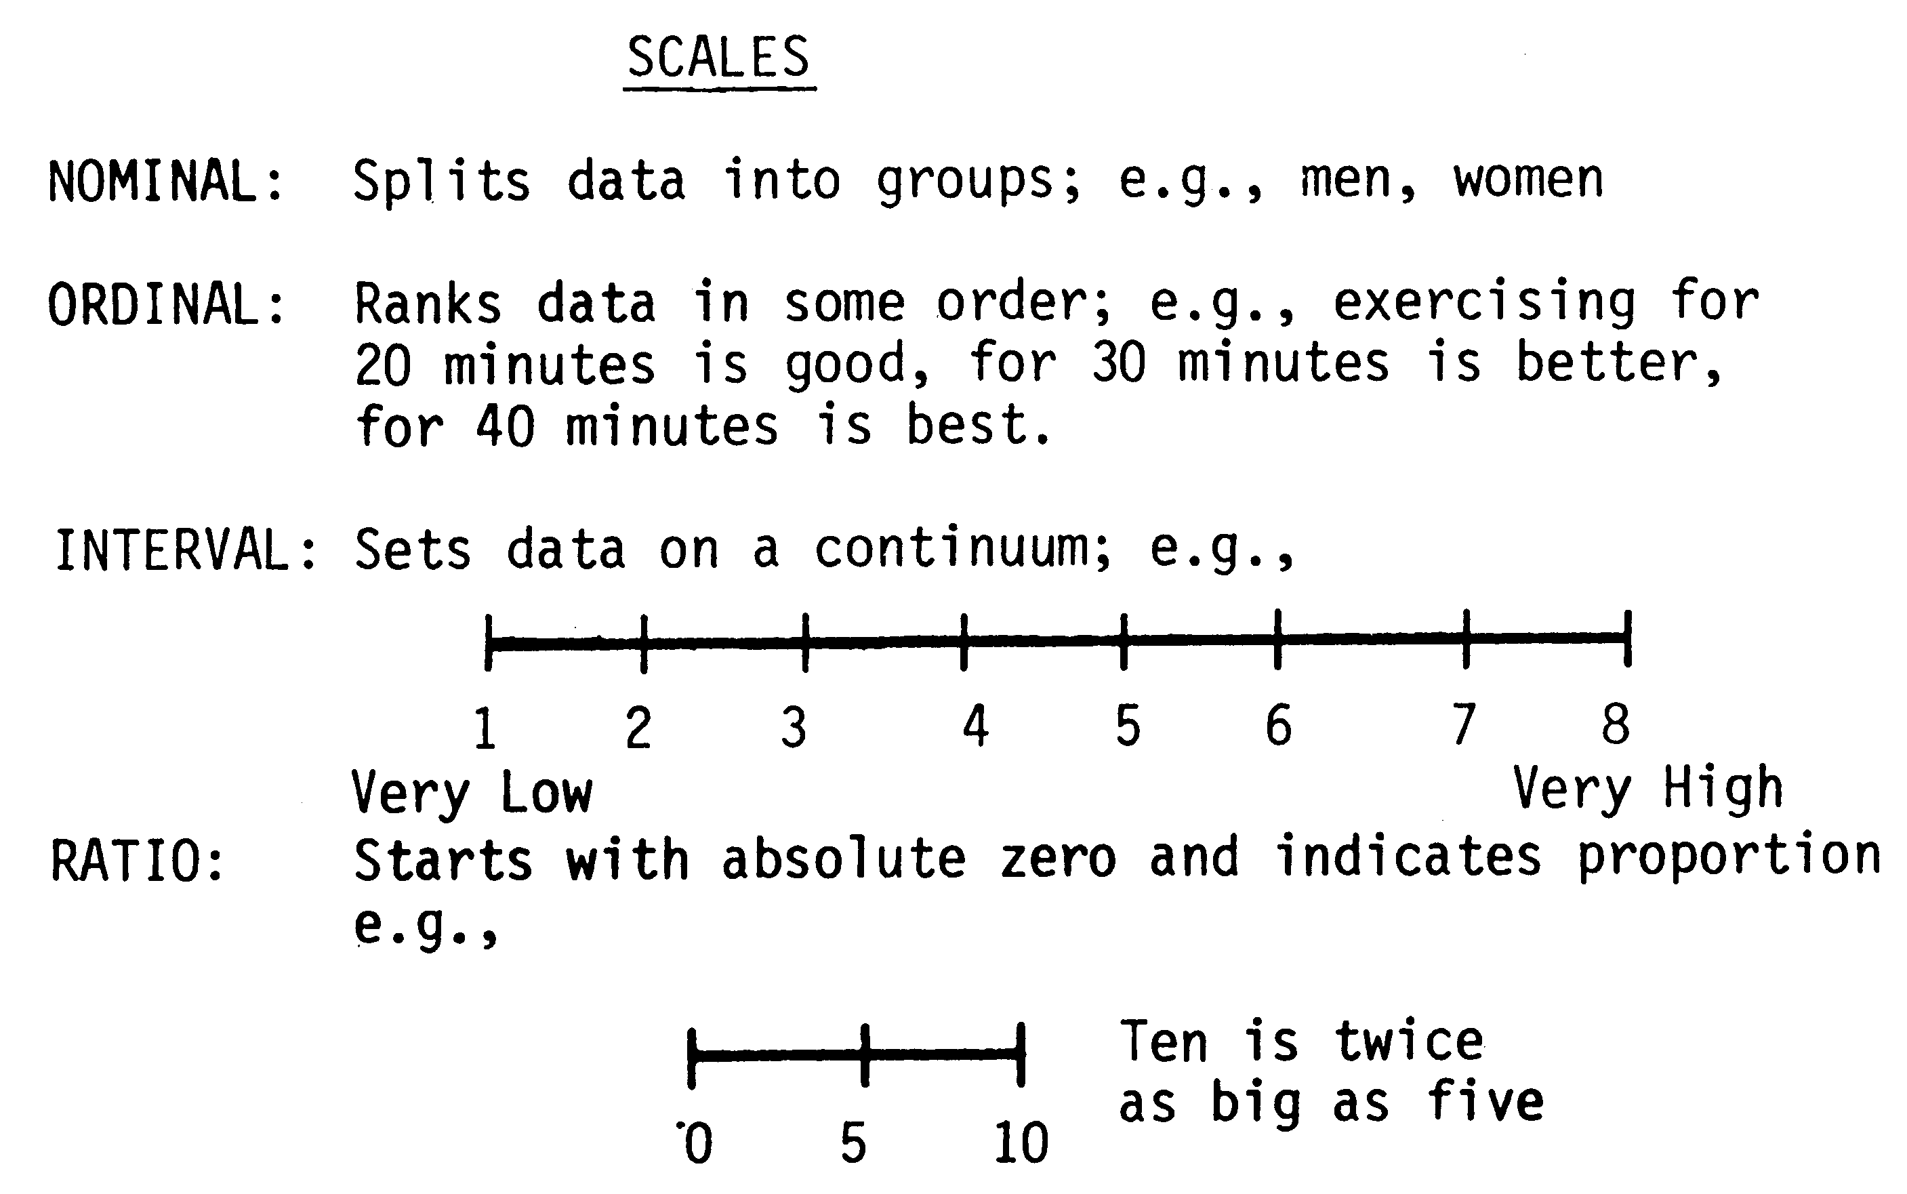
The differences between scales

Slide 27
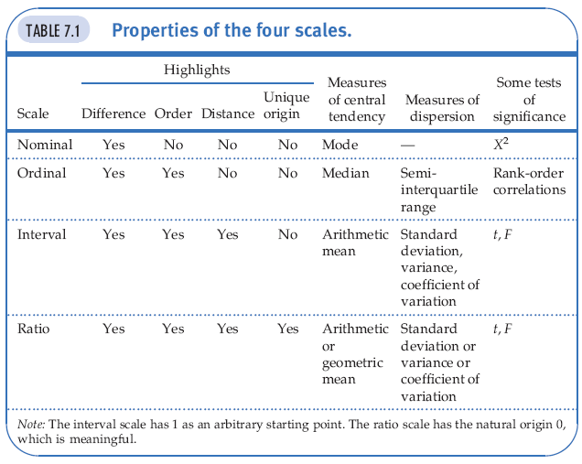
Properties of the Four Scales

Slide 28
Developing Scales
The four types of scales that can be used to measure the operationally defined dimensions and elements of a variable are:
Nominal, Ordinal, Interval, and Ratio scales.
It is necessary to examine the methods of scaling (assigning numbers or symbols) to elicit the attitudinal responses of subjects toward objects, events, or persons.

Slide 29
Developing Scales
Categories of attitudinal scales: (not to be confused with the four different types of scales)
The Rating Scales
The Ranking Scales

Slide 30
Developing Scales
Rating scales have several response categories and are used to elicit responses with regard to the object, event, or person studied.
Ranking scales, make comparisons between or among objects, events, or persons and elicit the preferred choices and ranking among them.

Slide 31
Rating Scales
The following rating scales are often used in organizational research.
Dichotomous scale
Category scale
Likert scale
Numerical scale

Slide 32
Rating Scales
Semantic differential scale
Itemized rating scale
Fixed or constant sum rating scale
Stapel scale
Graphic rating scale
Consensus scale

Slide 33
Dichotomous Scale
Is used to elicit a Yes or No answer.
(Note that a nominal scale is used to elicit the response)
Example 4
Do you own a car? Yes No

Slide 34
Category Scale
It uses multiple items to elicit a single response.
Where in Chitwan do you reside?
Parsa
Tandi
Bharatpur
Geetanagar
Other

Slide 35
Likert Scale
Is designed to examine how strongly subjects agree or disagree with statements on a 5-point scale as following:
_________________________________
Strongly Neither Agree Strongly
Disagree Disagree Nor Disagree Agree Agree
1 2 3 4 5
______________________________________________________

Slide 36
Likert Scale
This is an Interval scale and the differences in responses between any two points on the scale remain the same.

Slide 37
Semantic Differential Scale
We use this scale when several attributes are identified at the extremes of the scale. For instance, the scale would employ such terms as: Good – Bad
Strong – Weak
Hot – Cold

Slide 38
Semantic Differential Scale
This scale is treated as an Interval scale.
Example 6
What is your opinion on your supervisor?
Responsive--------------Unresponsive
Beautiful-----------------Ugly
Courageous-------------Timid

Slide 39
Numerical Scale
Is similar to the semantic differential scale, with the difference that numbers on a 5- points or 7-points scale are provided, as illustrated in the following example:
How pleased are you with your new job?
Extremely Extremlely
pleased 5 4 3 2 1 displeased

Slide 40
Itemized Rating Scale
A 5-point or 7-point scale is provided for each item and the respondent states the appropriate number on the side of each item. This uses an Interval Scale.
Example 7(i)
Respond to each item using the scale below, and indicate your response number on the line by each item.
1 2 3 4 5
Very unlikely unlikely neither likely very likely
unlikely nor
likely
--------------------------------------------------------------------------------
I will be changing my job in the near future. --------

Slide 41
Itemized Rating Scale
Note that the above is balanced rating with a neutral point.
The unbalance rating scale which does not have a neutral point, will be presented in the following example.

Slide 42
Itemized Rating Scale
Example 7(ii)
Circle the number that is closest to how you feel for the item below:
Not at all Somewhat Moderately Very much
interested interested interested interested
1 2 3 4
--------------------------------------------------------------------------------
How would you rate your interest 1 2 3 4
In changing current organizational
Policies?

Slide 43
Fixed or Constant Sum Scale
The respondents are asked to distribute a given number of points across various items.
Example : In choosing a toilet soap, indicate the importance you attach to each of the following five aspects by allotting points for each to total 100 in all.
Fragrance -----
Color -----
Shape -----
Size -----
_________
Total points 100
This is more in the nature of an ordinal scale.

Slide 44
Stapel Scale
This scale simultaneously measures both the direction and intensity of the attitude toward the items under study. The characteristic of interest to the study is placed at the center and a numerical scale ranging, say from +3 to – 3, on either side of the item as illustrated in the following example:

Slide 45
Example 8: Stapel Scale
State how you would rate your supervisor’s abilities with respect to each of the characteristics mentioned below, by circling the appropriate number.
+3 +3 +3
+2 +2 +2
+1 +1 +1
Adopting modern Product Interpersonal
Technology Innovation Skills
- 1 - 1 - 1
- 2 - 2 - 2
- 3 - 3 - 3

Slide 46
Graphic Rating Scale
A graphical representation helps the respondents to indicate on this scale their answers to a particular question by placing a mark at the appropriate point on the line, as in the following example:

Slide 47
Graphic Rating Scale
Example 9
On a scale of 1 to 10, how would you rate your supervisor?
10
5
1

Slide 48
Ranking Scales
Are used to tap preferences between two or among more objects or items (ordinal in nature). However, such ranking may not give definitive clues to some of the answers sought.

Slide 49
Ranking Scales
Example 10
There are 4 product lines, the manager seeks information that would help decide which product line should get the most attention.
Assume:
35% of respondents choose the 1st product.
25% of respondents choose the 2nd product.
20% of respondents choose the 3rd product.
20% of respondents choose the 4th product.
100%

Slide 50
Ranking Scales
The manager cannot conclude that the first product is the most preferred. Why?
Because 65% of respondents did not choose that product. We have to use alternative methods like Forced Choice, Paired Comparisons, and the Comparative Scale.
We will describe the Forced Choice as an example.

Slide 51
Forced Choice
The forced choice enables respondents to rank objects relative to one another, among the alternative provided. This is easier for the respondents, particularly if the number of choice to be ranked is limited in number.

Slide 52
Forced Choice
Example 11
Rank the following newspapers that you would like to subscribe to in the order of preference, assigning 1 for the most preferred choice and 5 for the least preferred.
الدستور-------
الرأي---------
أخبار اليوم----
الغد-----------
شيحان--------

Slide 53
Goodness of Measures
It is important to make sure that the instrument that we develop to measure a particular concept is accurately measuring the variable, and we are actually measured the concept that we set out to measure.

Slide 54
Goodness of Measures
We need to assess the goodness of the measures developed. That is, we need to be reasonably sure that the instruments we use in our research do indeed measure the variables they are supposed to, and that they measure them accurately.

Slide 55
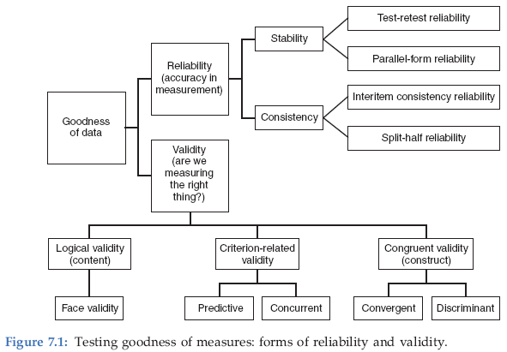
Goodness of Measures

Slide 56
Goodness of Measures
How can we ensure that the measures developed are reasonably good?
First an item analysis of the responses to the questions tapping the variable is done.
Then the reliability and validity of the measures are established.

Slide 57
Item Analysis
Item analysis is done to see if the items in the instrument belong there or not. Each item is examined for its ability to discriminate between those subjects whose total scores are high, and those with low scores.
In item analysis, the means between the high-score group and the low-score group are tested to detect significant differences through the t-values.

Slide 58
Item Analysis
The items with a high t-value are then included in the instrument. Thereafter, tests for the reliability of the instrument are done and the validity of the measure is established.

Slide 59
Reliability
Reliability of measure indicates extent to which it is without bias and hence ensures consistent measurement across time (stability) and across the various items in the instrument (internal consistency).
66

Slide 60
Stability
Stability: ability of a measure to remain the same over time, despite uncontrollable testing conditions or the state of the respondents themselves.
  Test–Retest Reliability: The reliability coefﬁcient obtained with a repetition of the same measure on a second occasion.
  Parallel-Form Reliability: Responses on two comparable sets of measures tapping the same construct are highly correlated.
84

Slide 61
Test-Retest Reliability
When a questionnaire containing some items that are supposed to measure a concept is administered to a set of respondents now, and again to the same respondents, say several weeks to 6 months later, then the correlation between the scores obtained is called the test-retest coefficient.
The higher the coefficient is, the better the test-retest reliability, and consequently, the stability of the measure across time.

Slide 62
Parallel-Form Reliability
When responses on two comparable sets of measures tapping the same construct are highly correlated, we have parallel-form reliability.
Both forms have similar items and the same response format, the only changes being the wording and the order or sequence of the questions.

Slide 63
Parallel-Form Reliability
What we try to establish in the parallel-form is the error variability resulting from wording and ordering of the questions.
If two such comparable forms are highly correlated (say 8 and above), we may be fairly certain that the measures are reasonably reliable, with minimal error variance caused by wording, ordering, or other factors.

Slide 64
Internal Consistency
Internal Consistency of Measures is indicative of the homogeneity of the items in the measure that tap the construct.
  Inter-item Consistency Reliability: This is a test of the consistency of respondents’ answers to all the items in a measure. The most popular test of inter-item consistency reliability is the Cronbach’s coefficient alpha.
  Split-Half Reliability: Split-half reliability reflects the correlations between two halves of an instrument.
72

Slide 65
Validity
Validity tests show how well an instrument that is developed measures the particular concept it is intended to measure. Validity is concerned with whether we measure the right concept.
Several types of validity tests are used to test the goodness of measures: content validity, criterion-related validity, and construct validity.

Slide 66
Content Validity
Content validity ensures that the measure includes an adequate and representative set of items that tap the concept.
The more the scale items represent the domain of the concept being measured, the greater the content validity.
In other words, content validity is a function of how well the dimensions and elements of a concept have been delineated.

Slide 67
Criterion-Related Validity
Criterion-Related Validity is established when the measure differentiates individuals on a criterion it is expected to predict. This can be done by establishing what is called concurrent validity or predictive validity.
Concurrent validity is established when the scale discriminates individuals who are known to be different; that is, they should score differently on the instrument as in the following example.

Slide 68
Criterion-Related Validity
Example 12
If a measure of work ethic is developed and administered to a group of welfare recipients, the scale should differentiate those who are enthusiastic about accepting a job and glad of a opportunity to be off welfare, from those who would not want to work even when offered a job.

Slide 69
Example 12 (Cont.)
Those with high work ethic values would not want to be on welfare and would ask for employment. Those who are low on work ethic values, might exploit the opportunity to survive on welfare for as long as possible.
If both types of individuals have the same score on the work ethic scale, then the test would not be a measure of work ethic, but of something else.

Slide 70
Construct Validity
Construct Validity testifies to how well the results obtained from the use of the measure fit the theories around which the test is designed. This is assessed through convergent and discriminant validity.
Convergent validity is established when the scores obtained with two different instruments measuring the same concept are highly correlated.
Discriminant validity is established when, based on theory, two variables are predicted to be uncorrelated, and the scores obtained by measuring them are indeed empirically found to be so.

Slide 71
Goodness of Measures
Goodness of Measures is established through the different kinds of validity and reliability.
The results of any research can only be as good as the measures that tap the concepts in the theoretical framework.
Table 7.2 summarizes the kinds of validity discussed in the lecture.

Slide 72
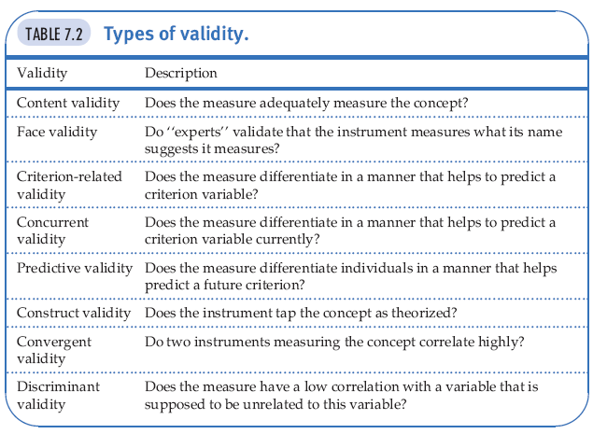
Validity
.

